Slide 1
Working Class Rental Fund
$3,000,000 fund that will only acquire performing properties that meet a 30% gross yield
Yield paid monthly to investor
Depreciation benefits
Upside appreciation potential
Sample properties next page

Slide 2
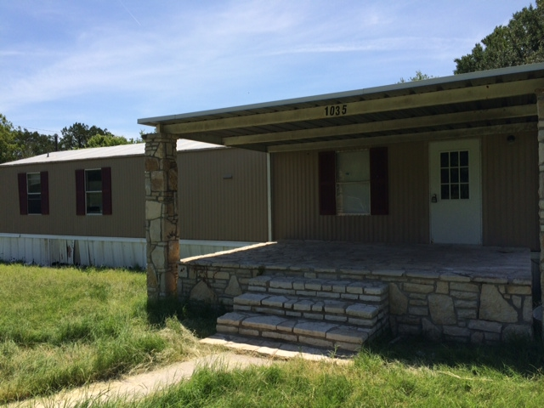
1035 Pawnee
Granbury, TX 76048
3 bedroom / 2 bathroom
Rented for $895 / month
3.3% Unemployment*
10.4% Below Poverty Line*
*zipskinny.com demographics

Slide 3
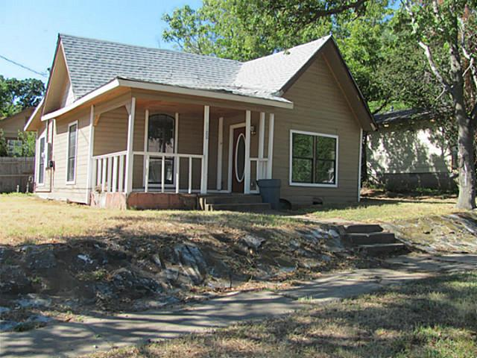
1100 Owings
Denison, TX 75020
2 bedroom / 1 bathroom
Rented for $650 / month
3.3% Unemployment*
12.6% Below Poverty Line*
*zipskinny.com demographics

Slide 4
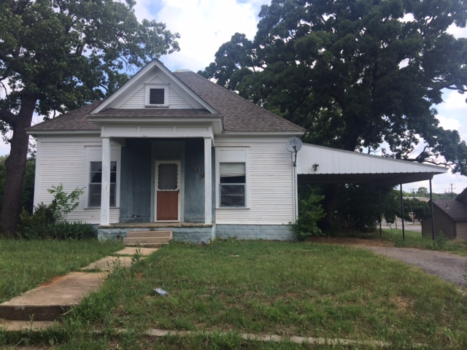
509 Rice
Denison, TX 75020
2 bedroom / 1 bathroom
Rented for $595 / month
3.3% Unemployment*
12.6% Below Poverty Line*
*zipskinny.com demographics

Slide 5
Ready Mortgage Corp
Incorporated in 1995 as a hard-money lending company
Began lending in multiple states in 2001 to improve yield by becoming geographically independent
Merged with a public company in 2003 maintaining a “compete” clause, then, separated in 2006
Transitioned from lending company to property management and preservation company on the 2008 portfolio of loans totaling $15MM in order protect investor capital – didn’t just liquidate portfolio
Leveraged that “transition” to buy/fix/sell via owner-financing beginning in 2009 to overcome value loss of the 2008 recession

Slide 6
Process Driven
Purchase – checklists managed by Shanna
Automated web-crawling for leads, post cards, etc
Rehab – checklists managed by Shanna
Developed over 20 years of hard money construction loans
Contractors paid upon completion or pre-determined milestone points
Independent contractor agreement and indemnification
Leasing – checklists managed by Sarah
Craigslist, Zillow, signs, newspaper as last resort
24 hour cell coverage
Collections
Automated email at 6:15am telling each staff member today’s action for each property delinquency
Maintenance/Make-ready
24 hour cell coverage
Sarah schedules – discussed every MWF at 10am team conference call
Evicting
Sarah coordinates the most efficient filing according to the quirks of a given precinct
Rent Raises
Automated email identifies expired leases and lists market rents for analysis

Slide 7
Ready Mortgage Corp
Moved to the Walmart-centric cities where there is greater supply of distressed product to improve yields and create geographical independence beginning in 2012
Currently have a mix of owner-financed properties and rentals in DFW, it’s outlying cities, Memphis and a recent couple of homes in Tulsa, and, obtained Oklahoma mortgage broker license
Currently have about 300 loans under management
Commercially purchased loan servicing and management software

Slide 8
Working Class Rental Fund
August 2014

Slide 9
Working Class Rental Fund
Capital
Loan
Mgmt LLC owns
property
Investor
LP
Rental
Debt
Monthly distrib as interest on K1
Loan Pmt
Mgmt LLC
Rent
Investor
LP
Rental
Prop mgmt, tax/ins, repairs, fund mgmt, etc

Slide 10
Quick Summary
C-level residential rental properties
Yield to investor payable monthly
Investor to receive depreciation
No leverage
Lease for 30% Gross Yield required to have fund purchase
Fund to acquire only performing properties
Typical deal
3-1 bought/repaired/rented
Rent at $650
Investor will receive a monthly statement, payment and access to web portal
Limited partnership capital structure with operating company firewall and RMC as fund manager
Accredited investors only

Slide 11
Quick Summary
Use of capital funds
6% expenses related to product purchase
94% product
$3,000,000 Fund
$25,000 average house
113 houses at $650/mo
$880,000 Gross Rents (Sample)
First Pay
$208,000 repairs (Escrow – shortages come from Last Pay, overages are escrowed forever-should be spending/saving a minimum here)
$131,000 Tax/ins (Escrow – shortages come from Last Pay – overages considered good management)
$88,000 Vacancy (Escrow – overages go to Last Pay)
$88,000 Property Mgmt (contract for 10% of gross rents)
$135,000 Fund management (contract for 15.3% of gross rents)
Second Pay
$150,000 Investor
Last Pay (encourages good property and fund management)
$80,000
Can be released to Property/Fund Management if an amount equal to a 12-month historical average of repairs/taxes/ins are escrowed, and, Second Pay has received full payment for past 12 months

Slide 12
Quick Summary – Exit Strategy
To be determined based on market conditions and macro-economics and/or specific investor needs
No specific time frame
Should not necessarily sell during a recession
Should not necessarily sell during a high inflation period
If an investor needs to exit, the options are
An existing investor(s) buys them out
The other investor(s) agree to sell off properties to liquidate the investor
A new investor(s) is brought in – must be approved
For any option, the terms and investor(s) must be approved unanimously
If any of the above options cannot be achieved, see Termination

Slide 13
Quick Summary - Termination
Any partner may terminate by issuing an amount they will pay in cash for the full fund and close in 120 days (Terminating Partner(s)), Non-terminating Partners have 60 days to choose to:
Buy or sell at that amount and terms, or,
Call for a property draft based on ownership – if management owns 5%, Round 1: Limited Partners choose 19 properties (pro-rata according to their ownership), management picks 1, Round 2: Limited Partners pick again, management picks again
If a limited partner(s) is the Buyer, they need only fund their current unfunded interest
E.g. $3,000,000 fund owned 99.9% by one limited partner and 0.1% by management and limited partner offers $3,000,000
If management decides to sell, limited partner only needs to fund $3,000
If management decides to buy, management needs to fund $3,000,000
E.g. $3,000,000 fund owned 90% by one limited partner and 10% by management and limited partner offers $3,300,000
If management decides to sell, limited partner only needs to fund $300,000
If management decides to buy, management needs to fund $3,000,000
Obviously, termination can be handled differently upon unanimous approval of all partners

Slide 14
Introduction
Operational Structure
Experience
Actual Examples

Slide 15
Operational Structure
WCR Fund II, LP
Partnership objectives
Funds accrued to Last Pay
Partnership Structure
Limited Partners
99.9% Ownership of both LP and Mgmt LLC
General Partner – WCRF Management II, LLC – initially 100% owned by capital investors; managers vest according to performance
Capital Raiser/Fund Expense(10% total if partnership objectives are met over time)
Performance earned with capital raised
Fund Management (20% total if partnership objectives are met over time)
Performance earned annually if overseeing Fund Management for the entire period, and, vesting issued for that period
Property Management (20% total if partnership objectives are met over time)
Performance earned annually if overseeing Fund Management for the entire year, and, vesting issued for that period
Earned interest according to WCRF Management II LLC vesting schedule
Managers are issued 5% ownership for meeting yearly partnership objectives first 6 times
Managers are issued 10% ownership for meeting yearly objectives 7th and 8th times

Slide 16
Operational Structure
Fund Management Responsibilities
Managing Property Management
Typical property manager requires oversight, direction and accountability
We monitor based on performance metrics (rent collected, vacancy, repairs, leasing)
Investor Relations
Bookkeeping/Accounting/Tax reporting
Hazard insurance management
As an aside, if a property is totalled by a hazard, insurance proceeds will be used to payoff loan to LP and any excess to be added to Last Pay Escrow and any shortage to be subtracted from Last Pay Escrow
Ensure repair coordination, efficiencies and consistencies for tenant satisfaction
Eviction coordination and compliance
Eviction fees come from vacancy escrow account
Lease coordination (property managers do not get leasing fee)
A lease fee is generally 1 month’s rent (8% of the annual rent) and to some extent adversely incentivizes the property manager, so, fund management handles the marketing to ensure an aggressive approach
Rental collection and reporting
Tenants deposit rent checks directly to bank, so, property managers do not generally handle money

Slide 17
Operational Structure
Property Management Responsibilities
Achieving collection follow-up that achieve Last Pay – generally limited to slow payers, door-knocking
Tax/Insurance efficiencies drop to Property Management line item, but, those negotiations are responsible here
Vacancy “savings” drop to Property Management line item
3-month’s vacancy > 10% for any property in any 12-month period is unacceptable (allows for Property Manager to not lose value related good markets/tenants, but, poorly performing properties/markets can be re-assigned by Fund Management)
Repair expenses > quarterly budget+escrowed savings is unacceptable unless can be paid from vacancy savings
Vacant properties will be inspected by Fund Management or a third-party after make-ready and prior to re-renting to assess any material indications of deferred maintenance

Slide 18
Operational Structure
Fund Mgmt
Craig
Mgr of Mgrs
Sarah
Granbury
Jarrod/Miriam
Mabank
Craig/Bo
Wichita Falls
Jarrod/Freddie
Denison
Jarrod/Ruben

Slide 19
Experience
Ready Mortgage Corp

Slide 20
Ready Mortgage Corp
Incorporated in 1995 as a hard-money lending company
Began lending in multiple states in 2001 to improve yield by becoming geographically independent
Merged with a public company in 2003 maintaining a “compete” clause, then, separated in 2006
Transitioned from lending company to property management and preservation company on the 2008 portfolio of loans totaling $15MM in order protect investor capital – didn’t just liquidate portfolio
Leveraged that “transition” to buy/fix/sell via owner-financing beginning in 2009 to overcome value loss of the 2008 recession

Slide 21
Ready Mortgage Corp
Moved to the Walmart-centric cities where there is greater supply of distressed product to improve yields and create geographical independence beginning in 2012
Currently have a mix of owner-financed properties and rentals in DFW, it’s outlying cities, Memphis and a recent couple of homes in Tulsa, and, obtained Oklahoma mortgage broker license
Currently have about 300 loans under management
Commercially purchased loan servicing and management software

Slide 22
Our Team
Craig Pettit
Jarrod Pettit
Shanna Kolp
Tu Phan
Thelma Dalizu
Jeanea Larranga
Marybelle Trevino
Sarah Day
Aide Benavides
Tiffany Kamuche (attorney – offices at RMC)
Julie Pettit (attorney – advisory capacity)

Slide 23
Our Team
Craig Pettit, President
Began C-level property investing in 1977
Began hard-money lending in 1991 and incorporated Ready Mortgage Corp in 1995
Licensed Texas and Oklahoma RMLO
Registered Texas Servicer
Bachelors in Math/CS from UTD – 1982
Employed by Rockwell International and Texas Instruments from 1985 – 1999
Currently servicing over 300 loans in excess of $12MM

Slide 24
Our Team
Jarrod Pettit
Has been buying/selling properties since 2002
Responsible for acquisitions, repairs, rentals and sales
Performs duties related to collections, rental management and tenant relations

Slide 25
Our Team
Shanna Kolp, Underwriting, Compliance and Process Manager
Has worked for RMC for 10+ years
She works remotely from Wisconsin but has significant duties at RMC
Manages the following departments
Servicing (collections, delinquency, extensions, etc.)
Corporate calendar
Procedures manual updates
Payroll
Construction repair due diligence and approval

Slide 26
Our Team
Tu Phan, Accounting Manager
Has worked for RMC for 7+ years
Manages all things “accounting” – except reconciliation
Ensures Servicing and Accounting systems balance
Monthly investor statements
Accounts payable/receivable
Payoffs, fundings, draws

Slide 27
Our Team
Thelma Dalizu, Administrative Assistant
Has worked for RMC for 10+ years
Reconciles bank statements
Prepares loan extensions
Handles investor paperwork
Other miscellaneous duties
Jeanea Larranaga, Accounting and Admin
Processes payments
Handles translation services
Accounts payable
Collections phone calls

Slide 28
Our Team
Marybelle Trevino, Administrative Assistant
Post-closing audits
Investor documentation
Collection phone calls
Sarah Day, Manager of Property Managers
Licensed Realtor
Property manager
Aide Benavides
Loan Application Processor
Collection phone calls
Sales/rentals
Tiffany Kamuche, Attorney
Compliance support

